Slide 1


Slide 2

When a user invokes any one of the use cases of a system, the required behaviour is realized through the interaction of several objects in the system.
An interaction diagram describes how groups of objects interact among themselves through message passing to realize some behaviour (execution of a use case)
Notes:
Use Case Relationship
Association relationship
May exist between actor and a use case
Often referred to as a communicate association
Navigable in both directions (actor to use case and use case to actor)
Some use just a line
Others use a double-headed arrowhead
Navigable in only one direction (actor to use case OR use case to actor)
Use a arrowhead where arrowhead denotes the direction of communication
Navigation direction of an association represents who is initiating the communication
Multiplicity
Not consistency shown on all use-case diagrams (Some do; some don’t)

Slide 3
Sometimes, more than one interaction diagram may be necessary to capture the behaviour.
2 kinds
– sequence diagrams and collaboration diagrams.
2 diagrams are equivalent
-in the sense that any one diagram can be derived automatically from the other.
Notes:
Use Case Relationship
Association relationship
May exist between actor and a use case
Often referred to as a communicate association
Navigable in both directions (actor to use case and use case to actor)
Some use just a line
Others use a double-headed arrowhead
Navigable in only one direction (actor to use case OR use case to actor)
Use a arrowhead where arrowhead denotes the direction of communication
Navigation direction of an association represents who is initiating the communication
Multiplicity
Not consistency shown on all use-case diagrams (Some do; some don’t)

Slide 4

It shows the interactions among objects as a two dimensional chart.
The chart is read from top to bottom.
The objects participating in the interaction are drawn at the top of the chart as boxes attached to a vertical dashed line
Notes:
Use Case Relationship
Association relationship
May exist between actor and a use case
Often referred to as a communicate association
Navigable in both directions (actor to use case and use case to actor)
Some use just a line
Others use a double-headed arrowhead
Navigable in only one direction (actor to use case OR use case to actor)
Use a arrowhead where arrowhead denotes the direction of communication
Navigation direction of an association represents who is initiating the communication
Multiplicity
Not consistency shown on all use-case diagrams (Some do; some don’t)

Slide 5

If object created during execution then shown at appropriate place
Objects existence are shown as dashed lines (lifeline)‏
Objects activeness, shown as a rectangle on lifeline

Slide 6

Messages are shown as arrows.
Each message labelled with corresponding message name.
Each message can be labelled with some control information.
Two types of control information:
  -condition ([])‏
  -iteration (*)‏

Slide 7

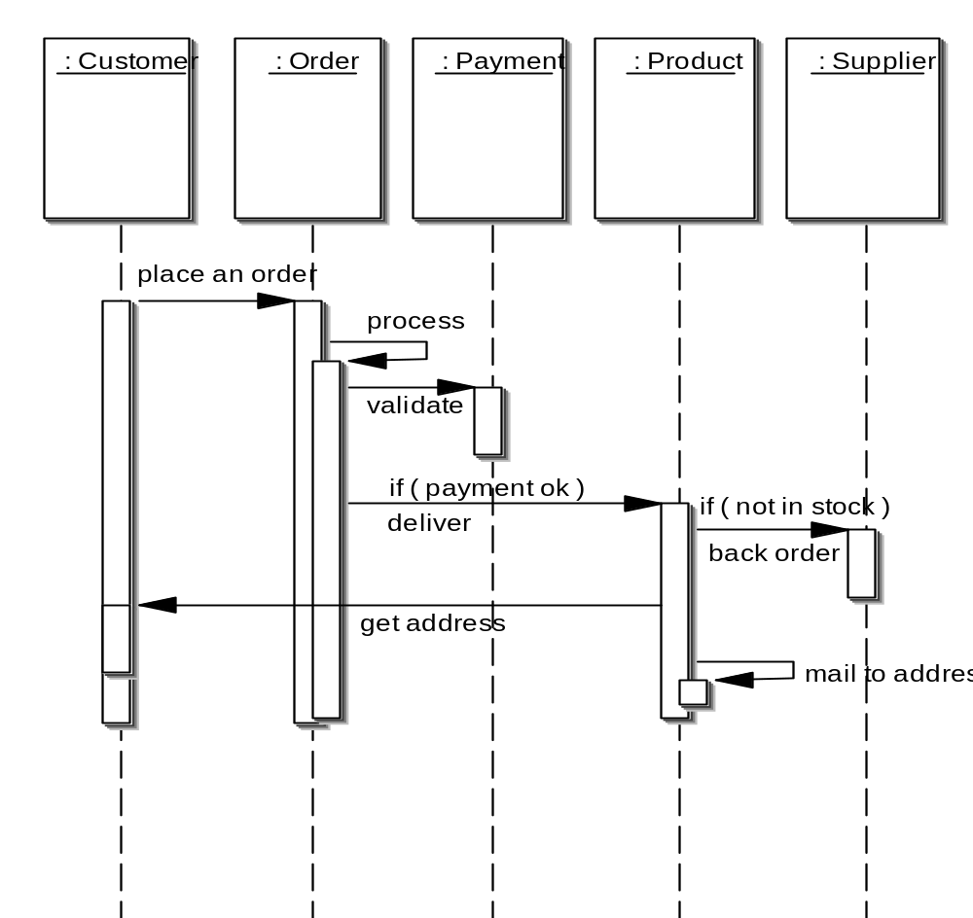
object
control
lifetime
message

Slide 8

Sequence of message sending

Slide 9

:Library
Boundary
:Library
Book
Renewal
Controller
:Library
Book
Register
:Book
:Library
Member
renewBook
find MemberBorrowing
displayBorrowing
selectBooks
bookSelected
* find
[reserved]
[reserved]
apology
update
apology
confirm
confirm
updateMemberBorrowing
Sequence Diagram for the renew book use case

Slide 10

Shows both structural and behavioural aspects
Objects are collaborator, shown as boxes
Messages between objects shown as a solid line
A message is shown as a labelled arrow placed near the link
Messages are prefixed with sequence numbers to show relative sequencing

Slide 11

:Library
Book
Register
6: * find
:Book
[reserved]
9: update
8: apology
5: book
Selected
10: confirm
:Library
Boundary
1: renewBook
:Library
Book
Renewal
Controller
[reserved]
7: apology
3: display
Borrowing
4: selectBooks
2: findMemberBorrowing
12: confirm
:Library
Member
updateMemberBorrowing
Collaboration Diagram for the renew book use case

